Slide 1
EXAMINATION OF RISK FACTORS STRONGLY ASSOCIATED WITH THE LIKELIHOOD OF DEVELOPING DIABETES IN THE UNITED STATES
Project 1I
Group 5 - Erika Pham, Mohamed Sillah Kanu, Sri Varshini Yaddanapudi

Slide 2
OVERVIEW OF CONTENT
1. Project 1 summary
2. Statistical Modeling
A. Logistic Regression
B. Classification Tree
C. Random Forest
3. Future Improvements and Conclusion

Slide 3
ABOUT THE PROJECT AND DATA
Diabetes is a common chronic condition that affects millions of people. In the US, 37.3m people have diabetes and 96m have prediabetes.​
Many complications: heart disease, vision loss, lower-limb amputation, etc.
SMART question – which risk factors are most associated with the likelihood of developing prediabetes/diabetes?
There is no cure - treatment include lifestyle changes (diet & exercise, losing weight) and medical treatment (pills, insulin injections, etc.)
Learning which factors (age, lifestyle, etc.) correlate with prediabetes/diabetes could help with diagnosis and treatment.

Slide 4
About The data
CDC conducts an annual health-related telephone survey called The Behavioral Risk Factor Surveillance System (BRFSS). It collects responses from over 400,000 Americans on health-related risk behaviors, chronic health conditions, and the use of preventative services.
The original dataset is from the 2015 survey. It contains responses from 441,455 individuals and has 330 features. The features are either questions directly asked of participants, or calculated variables based on individual participant responses.
Our dataset was subsetted by Alex Teboul on Kaggle. It has 21 variables, 70692 data points, and split 50-50 between respondents with pre/diabetes and without.
To subset, he chose features that were related to diabetes risk factors identified in medical research. All missing values dropped. Respondents w/ and w/o pre/diabetes were selected randomly to yield an even 50-50 split for balanced dataset.

Slide 5
VARIABLE DESCRIPTIONS – BIODEMOGRAPHIC VARIABLES
Variable | Description | Code
Sex |  | 0 = female, 1 = male
Age | 13-level age category | 1 = 18-24, 2 = 25-29, 3 = 30-34, 4 = 35-39, 5 = 40-44, 6 = 45-49, 7 = 50-54, 8 = 55-59, 9 = 60 - 64, 10 = 65-69, 11 = 70-74, 12 = 75-79, 13 = 80 and older
Education | Education level scale 1-6 | 1 = never attended/only kindergarten, 2 = grades 1-8, 3 = grades 9 -11, 4 = grade 12 or GED (graduated HS), 5= college 1-3 yrs, 6 = college 4+ yrs (graduated college).
Income | Income scale from 1-8 | 1 = <$10k, 2 = <$15k, 3 = <$20k, 4 = <$25k, 5 = <$35k, 6 = <$50k, 7 = <$75k, 8 = $75k+.

Slide 6
VARIABLE DESCRIPTIONS – HEALTH INDICATORS
Variable | Description | Code
HighBP | Have you ever been told (by a medical professional) that you have high blood pressure? | 0 = no high blood pressure, 1 = high blood pressure
HighChol | Have you ever been told that you have high cholesterol? | 0 = no high cholesterol, 1 = high cholesterol
BMI | measure of body fat based on height and weight | Body Mass Index
Stroke | Ever been told you had a stroke | 0 = no, 1 = yes
HeartDiseaseorAttack | Coronary heart disease (CHD) or myocardial infarction | 0 = no, 1 = yes
GenHlth | Would you say that in general your health is: scale 1- 5 | 1 = excellent, 2 = very good, 3 = good, 4 = fair, 5 = poor
MentHlth | Days of poor mental health scale 1 - 30 days
PhysHlth | Physical illness or injury days in past 30 days scale 1-30 days

Slide 7
VARIABLE DESCRIPTIONS – BEHAVIORAL/OTHER FACTORS
Variable | Description | Code
Smoker | Have you smoked at least 100 cigarettes (5 packs) in your entire life? | 0 = no, 1 = yes
PhysActivity | physical activity in the past 30 days - not including job | 0 = no, 1 = yes
Fruits | Consume fruit 1 or more times per day | 0 = no, 1 = yes
Veggies | Consume vegetables 1 or more times per day | 0 = no, 1 = yes
HvyAlcoholConsumption | adult men >= 14 drinks/week, adult women >= 7 drinks/week | 0 = no, 1 = yes
AnyHealthcare | Have any kind of health care coverage, including health insurance, prepaid plans such as HMO, etc. | 0 = no, 1 = yes
NoDocbcCost | Was there a time in the past 12 months when you needed to see a doctor but couldn't bc of cost? | 0 = no, 1 = yes
DiffWalk | Do you have serious difficulty walking or climbing stairs? | 0 = no, 1 = yes

Slide 8
PROJECT 1 SUMMARY
In EDA, through chi-square tests, we found that all variables had correlation with our target variable, “diabetes”.
The dependent variable is categorical -> classification problem
Models to use: logistic regression, classification tree, random forests

Slide 9
STATISTICAL MODELLING
1. Logistic Regression
2. Classification Tree
3. Random Forests

Slide 10
LOGISTIC REGRESSION
Dependent Variable: diabetes – 1, if have prediabetes/diabetes
Independent Variables: After using feature selection on our model based on AIC, the best model have 17 variables:
Diabetes_binary ~ HighBP + HighChol + CholCheck + BMI + Stroke + HeartDiseaseOrAttack+ PhysActivity + Veggies + HvyAlcoholConsumption+ GenHlth + MentHlth + PhysHlth + DiffWalk + Sex + Age + Education + Income
Train/test ratio is 80:20

Slide 11
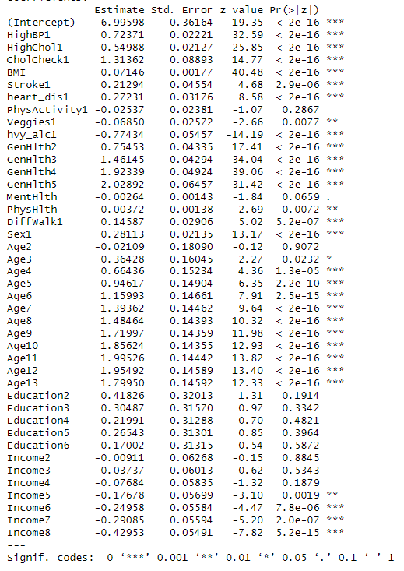
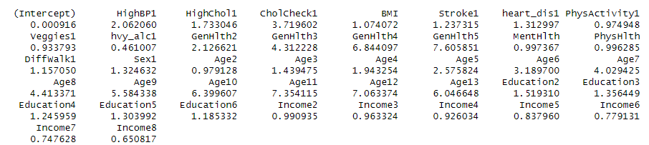
LOGISTIC REGRESSION - RESULTS
Generally, coefficients for the health indicators were statistically significant
For example, having high blood pressure increased the probability of having pre/diabetes by a factor of 2.06. Similarly, having high cholesterol increased the probability of having pre/diabetes by a factor of 1.73.
Higher education level does not seem to have a significant relationship with diabetes
Higher income levels decreases the probability of having pre/diabetes

Slide 12
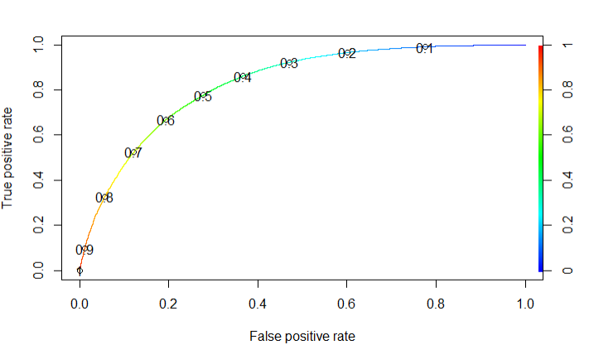
LOGISTIC REGRESSION - EVALUATION
We want to limit false negatives, as it’s not favorable to predict someone not having diabetes when they actually do
Assuming higher sensitivity is better in this case, we want a lower cutoff value

Slide 13
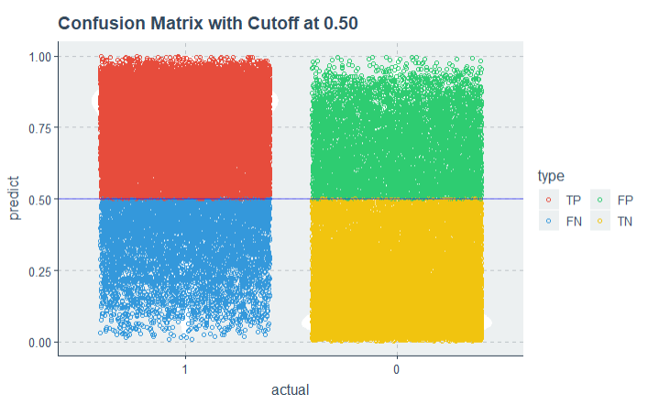
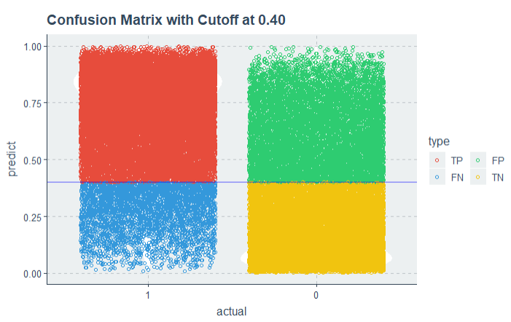
LOGISTIC REGRESSION - EVALUATION
0.4 is a better cutoff, as it lowers false negatives
After testing, also shows better accuracy

Slide 14
LOGISTIC REGRESSION - EVALUATION
Confusion matrix - training
Confusion matrix - testing
0
1
0
1
10346
17895
1945
5160
0
0
24325
3916
5501
1604
1
1
 | Training | Testing
Accuracy | 25.3 | 25.8
Pseudo R² | 0.268 | 0.263
Precision | 36.6 | 37.2
Recall | 30.3 | 30.3
F1 Score | 33.4 | 33.4
AUC | 0.828 | 0.824

Slide 15
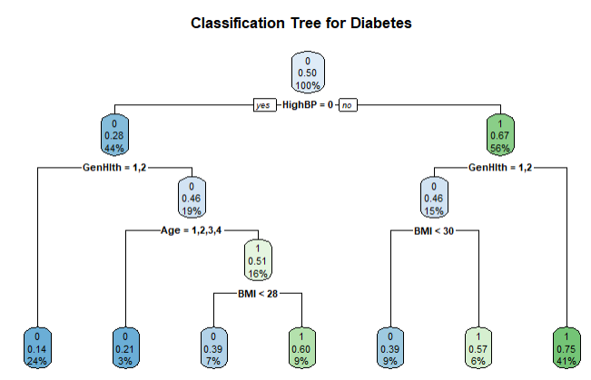
CLASSIFICATION TREE
Train/test ratio is 80:20

Slide 16
INTERPRETATION
For High Blood Pressure, the Gini Impurity for participants that have diabetes is 0.28. This means that there is 28% chance of misclassifying a randomly selected record from this node.

Slide 17
INTERPRETATION
For High Blood Pressure, the Gini Impurity for participants that do not have diabetes is 0.67. This means that there is 67% chance of misclassifying a randomly selected record from this node.

Slide 18
INTERPRETATION
The Gini Impurity for participants that have diabetes with excellent/good health is 0.14. This means that there is 14% chance of misclassifying a randomly selected record from this node.

Slide 19
INTERPRETATION
The Gini Impurity for participants that have diabetes without excellent/good health is 0.46. This means that there is 46% chance of misclassifying a randomly selected record from this node.

Slide 20
INTERPRETATION
The Gini Impurity for participants that have diabetes with excellent/good health and are found within the age bracket 18-39 years is 0.21. This means that there is 21% chance of misclassifying a randomly selected record from this node.

Slide 21
INTERPRETATION
The Gini Impurity for participants that have diabetes without excellent/good health and are found within the age bracket 18-39 years is 0.51. This means that there is 51% chance of misclassifying a randomly selected record from this node.

Slide 22
INTERPRETATION
The Gini Impurity for participants that have diabetes without excellent/good health and are found within the age bracket 18-39 years with a BMI less 28 is 0.39. This means that there is 39% chance of misclassifying a randomly selected record from this node.

Slide 23
INTERPRETATION
The Gini Impurity for participants that do not have diabetes with excellent/good health is 0.46. This means that there is 46% chance of misclassifying a randomly selected record from this node.

Slide 24
INTERPRETATION
The Gini Impurity for participants that do not have diabetes without excellent/good health is 0.75. This means that there is 75% chance of misclassifying a randomly selected record from this node.

Slide 25
INTERPRETATION
The Gini Impurity for participants that do not have diabetes with excellent/good health and a BMI less than 30 is 0.39. This means that there is 39% chance of misclassifying a randomly selected record from this node.

Slide 26
INTERPRETATION
The Gini Impurity for participants that do not have diabetes with excellent/good health and a BMI greater than 30 is 0.57. This means that there is 57% chance of misclassifying a randomly selected record from this node.

Slide 27
CLASSIFICATION TREE - EVALUATION
Confusion matrix - training
Confusion matrix - testing
0
1
0
1
18759
5881
4706
1485
0
0
9482
22360
2399
5620
1
1
 | Training | Testing
Accuracy | 72.8 | 72.7
Precision | 76.1 | 76
Recall | 66.4 | 66.2
F1 Score | 70.9 | 70.8

Slide 28
RANDOM FORESTS - EVALUATION
Confusion matrix - training
Confusion matrix - testing
0
1
0
1
27164
1738
4968
1503
0
0
1077
26503
2137
5602
1
1
 | Training | Testing
Accuracy | 95 | 74.4
Precision | 94 | 76.8
Recall | 96.2 | 69.9
F1 Score | 95.1 | 73.2

Slide 29
FUTURE IMPROVEMENTS & CONCLUSION
 | Logistic Regression | Classification Tree | Random Forests
Accuracy | 25.3 | 25.8
Precision | 36.6 | 37.2
Recall | 30.3 | 30.3
F1 Score | 33.4 | 33.4
Random forests performed best, but is it overfitted?
Need to improve the accuracy for logistic regression
Try other models, such as KNN or gradient boosting

